Slide 1


Norwalk Transportation Project
MVP Slide Deck

Slide 2




Design Challenge
To provide guidance to the city of Norwalk to make it easier for residents and visitors to wayfind using the city’s public transit infrastructure.

Slide 3




Prototype Portfolio
User Journey Map & Simulator
Wayfinding App & App Patches
Physical Signage & Kiosks
Transit Difficulty Map & Analytical Tool

Slide 4
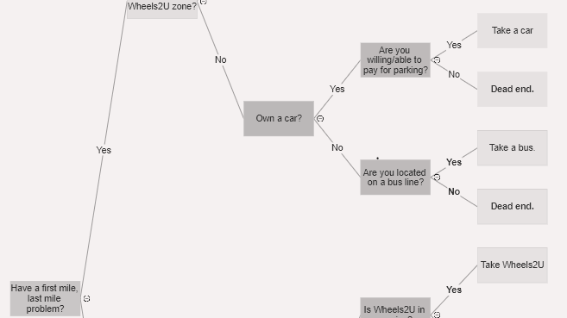
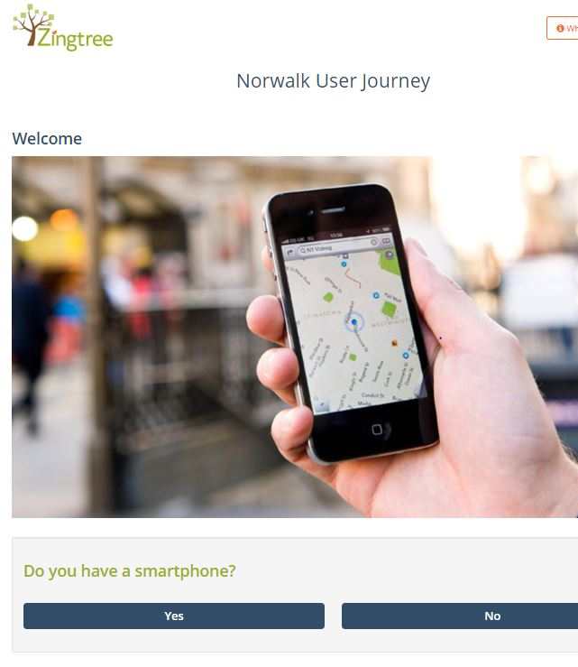
User Journey Map & Simulator
Uses user research to map the experiences of different types of public transit users
Each path represents a different possible user experience
Can be refined and updated as new information is obtained
Helps planners identify obstacles and opportunities across the broader public transit system
Informs future transit-related policy and development
Demo: https://zingtree.com/host.php?tree_id=761981665

Slide 5
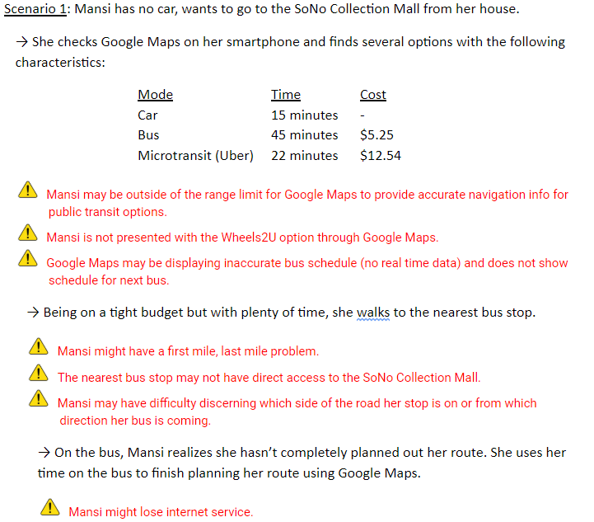
Example Use Case: No car scenario

Slide 6
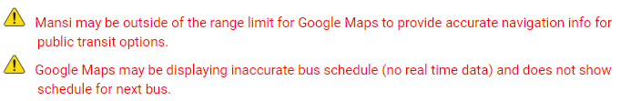
Wayfinding App & App Patches
Insights gleaned from User Journey Map Simulator become features in new local transit app
Other insights become supplements to existing Navigation apps, like Google Maps

Slide 7
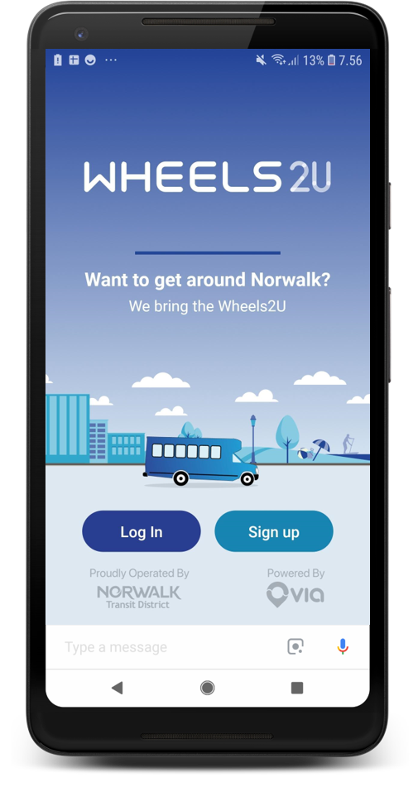
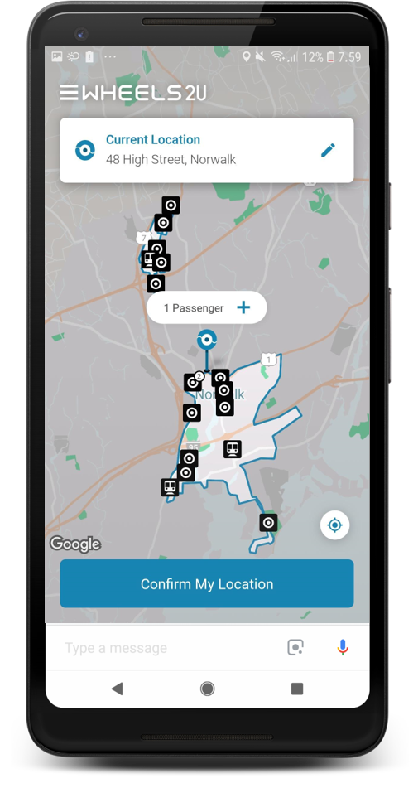
Norwalk Transit App

Slide 8
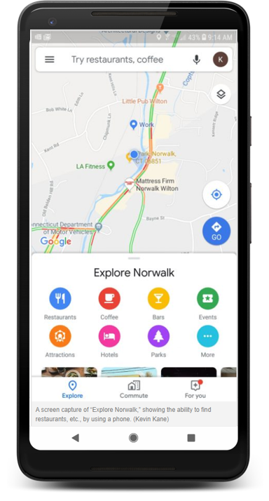
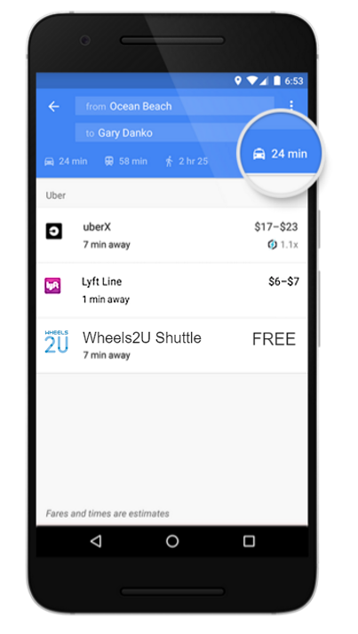
Norwalk Transit Patch for Google Maps

Slide 9

Physical Signage & Kiosks
Other insights become physical signage, directories, or interactive kiosks

Slide 10
“We imagine the downtown area becoming like a big, friendly, open air mall.”
-Resident of Norwalk Arts District

Slide 11
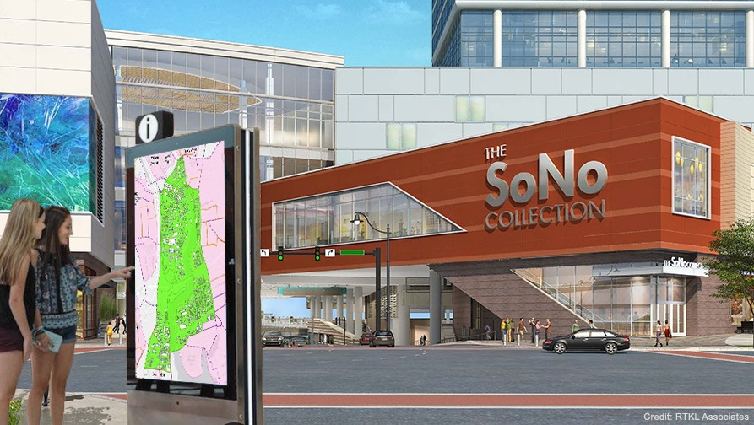
Physical Signage and Kiosks

Slide 12
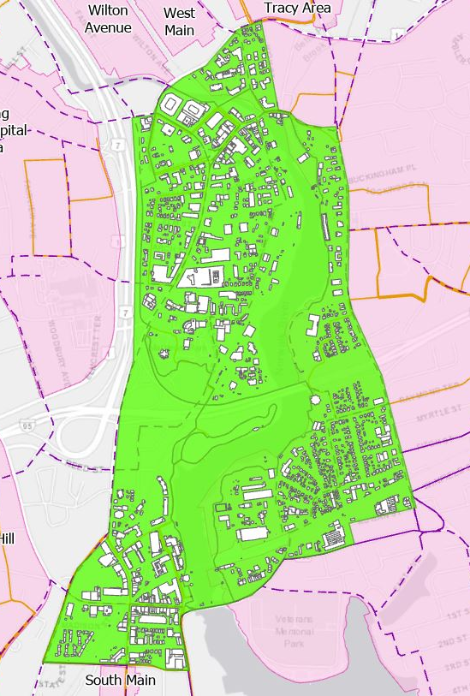
User-view District Maps
Present the District’s destinations and other assets as the average user views them (through the lens of accessibility)
Generated using standard analytical protocol, which redraws District boundaries using most common measures of user accessibility
Travel time
Number of modes/connections
Total distance walking
Cost
Deployed via interactive kiosks installed in each District’s “natural center” and/or wayfinding app

Slide 13
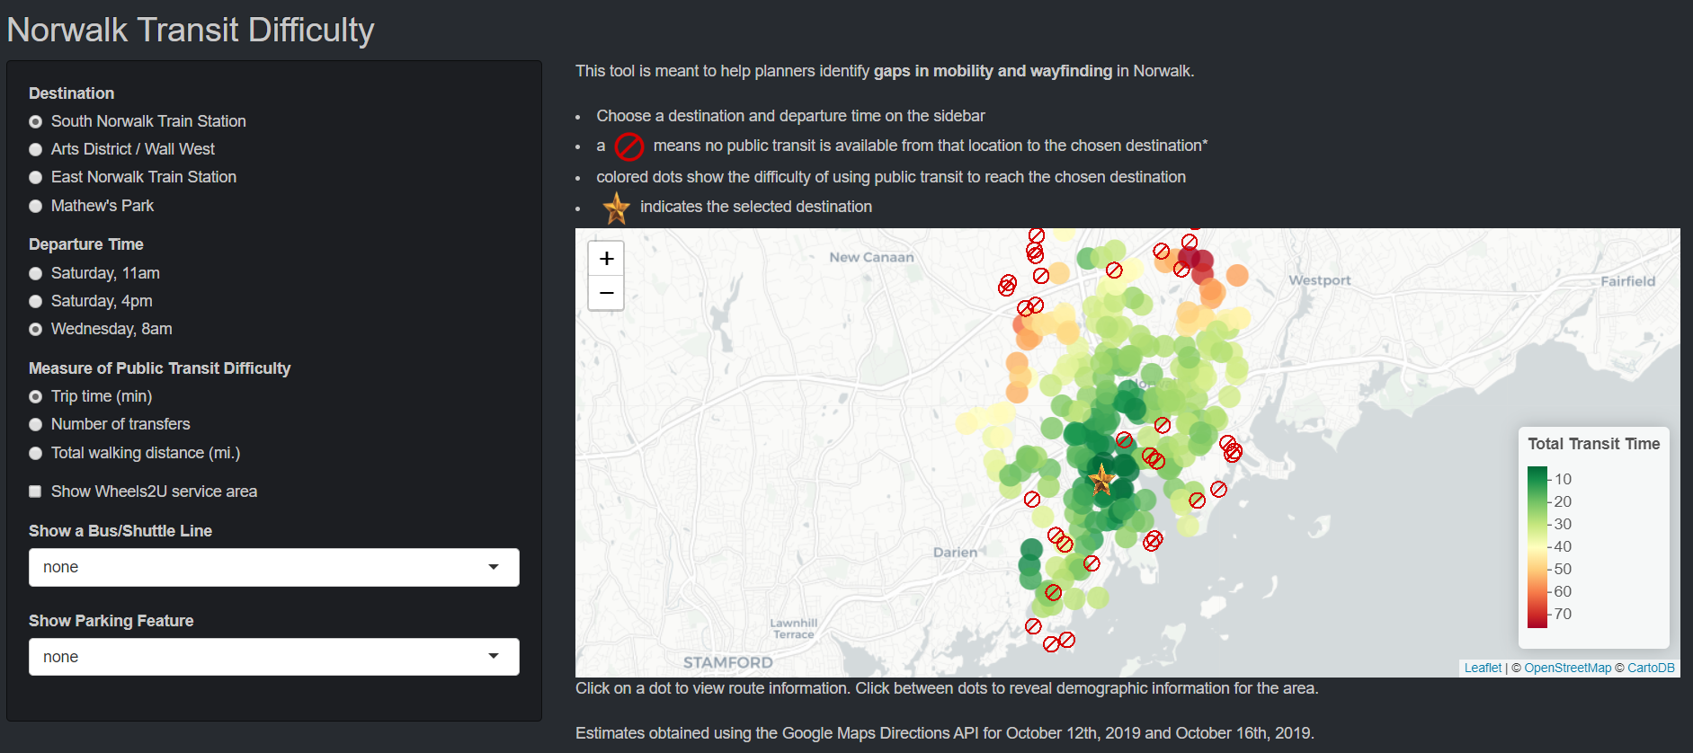
Transit Difficulty Map & Analytical Tool
https://dkori.shinyapps.io/Norwalk_Transit_Map/

Slide 14
Unintended Consequences
Stratification:
Economic
Geographic
Technological

Slide 15
Thank you

